Slide 1
Train delays & weather
Large-Scale Data Architectures Final Project
Bernáth Máté
2025/12/16

Slide 2
Agenda
Business Aspects
Stakeholders
Value Added
KPIs
Data pipeline
Data Pipeline
Cost Breakdown
architecture
Preprocessing
Athena Database
Weekly Update Pipeline
Closing Remarks
Future Considerations
Technical Details

Slide 3
Business aspects
Stakeholders, business benefits and KPIs

Slide 4
Stakeholders
MÁV Pályaműködtetési Zrt.
Infrastructure management
MÁV Zrt. Haváriaközpont
Managing crises
MÁV Zrt.
Central governing hub
Prioritize large impact infrastructure upgrades
Monitor stations with worst historical resilience
Likely initiating the project
Schedules and maintenance approval

Slide 5
Added value of the project
Seeing clearly
Identifies problematic regions and stations
The effect of weather
Correlates delays with weather events
Optimized resource allocation
Allows MÁV to strategically upgrade infrastructure
Enables trend analysis
Tracks patterns over time to monitor improvements
Supports data-driven decision-making
Prevents wasteful spending of limited resources
Makes pre-emptive maintenance possible

Slide 6
Median delay
Regional median of delays >5 min
Pest is the worst with 8.33 min and Budapest is the best with 5.56 min
Temperature has greatest effect in Dél-Alföld with +1.87 min
Wind has no effect, all <1 min change
Precipitation has greatest effect in Budapest with +2.13 min
Sometimes positive effect, greatest in Dél-Alföld where if windy -0.8 min

Slide 7
DELAY SCORE
Percent of days that have >5 min average delays where there was >10 trains that day
Top 10 chronically delayed stations, all with a 100% track record, ordered by observed days
Közép-Dunántúl and Nyugat-Dunántúl is overrepresented with 4-4 stations

Slide 8
RESILIENCE SCORE
Percent of days that have max. 5 min average delay on extreme weather days
Worst 10 stations, all with a 0% track record, ordered by observed days
There are no overrepresented regions, stations are distributed
Notes:
Onto implementation from here

Slide 9
Data pipeline & cost breakdown
Layers and their services with associated costs

Slide 10
Data pipeline layers
01 Sources
02 S3 Storage
03 Processing
04 Updates
05 Analytics
MÁV delays CSV
Open-Meteo API
Station metadata
Delay data
Station mappings
Processed outputs
Query results
Glue ETL jobs
Filtering delays
Aggregating data
Joining metadata
AWS Lambda triggers ETL jobs after upload
Updates Athena database
Amazon Athena database
External tables and unified view

Slide 11
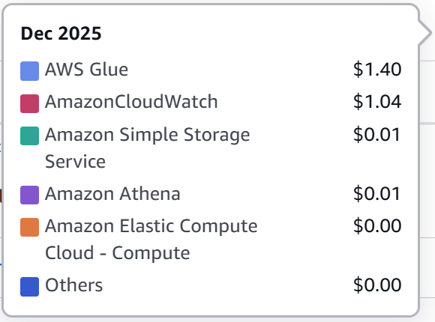
cost breakdown
2.45 USD/MONTH
99% AWS Glue + CloudWatch
Heavy lifting: ETL jobs & API calls
<1% S3 Storage
Small size, textual data files
<1% Amazon Athena
Few queries currently
Adding QuickSight dashboard would increase costs

Slide 12
architecture
Preprocessing, initial load, ETL jobs, Athena

Slide 13
Preprocessing in R
Delays data
Weather data
01
Date filtering, data cleaning
Remove early arrivals
02
Aggregation daily level
Aggregation station level
03
Add common Station ID
Export to CSV
01
Coordinate extraction
Create county boundaries
02
County assignment
Add NUTS-2 region + Region ID
03
Export Stations & Regions lookup CSV
Export weather data to CSV

Slide 14
Athena database
Delays All Table
2025/06/01 to 2025/12/07
Delay data for all 2467 stations
Weather All Table
2025/06/01 to 2025/12/07
NUTS-2 regions daily weather data with flags added
Stations & Regions Table
Bridge table to connect stations and regional weather
For all 2467 stations
Date | Station ID | Station Name | Total Delay | Train Count | Mean Delay
2025-06-01 | 30 | Abaliget | 2 min | 10 | 0.20 min
2025-06-01 | 32 | Abaújszántó | 2 min | 9 | 0.22 min
Region ID | Lat. | Lon. | Date | Mean Temp. | Sum of Precip. | Wind Gust | Temp Flag | Precip. Flag | Wind Flag
0 | 48.12 | 20.85 | 2025-06-01 | 21 °C | 1.3 mm | 38.2 km/h | 0 | 0 | 0
0 | 48.12 | 20.85 | 2025-06-01 | 23 °C | 0 mm | 38.2 km/h | 0 | 0 | 0
Station Name | Lat. | Lon. | County | Region | Station ID
Aba-Sárkeresztúr | 47.02 | 18.54 | Fejér | Közép-Dunántúl | 29
Abaliget | 46.15 | 18.08 | Baranya | Dél-Dunántúl | 30

Slide 15
Weekly Update pipeline
01 MANUAL
02 LAMBDA
03 GLUE ETL JOBS
04 ATHENA
Weekly delays CSV upload
Triggered by upload
Runs 3 ETL jobs in sequence
Filtering delays, updating delays table
Weather API calls, updating weather table
Updating unified view
Rerun KPI queries to see updated results

Slide 16
AWS GLUE ETL JOBS
Weekly delays update
Unified view update
Creates extreme weather flags
Weekly weather update
Runs only after other two have finished
Delay > Station ID > [bridge table] > Region ID > Weather
Updates UNIFIED ALL Athena view
Casts raw CSV fields to correct data types
Stages in temp path
API fetches regional daily weather for extracted date range
Stages in temp path
Inserts to DELAYS ALL Athena table
Inserts to WEATHER ALL Athena table

Slide 17
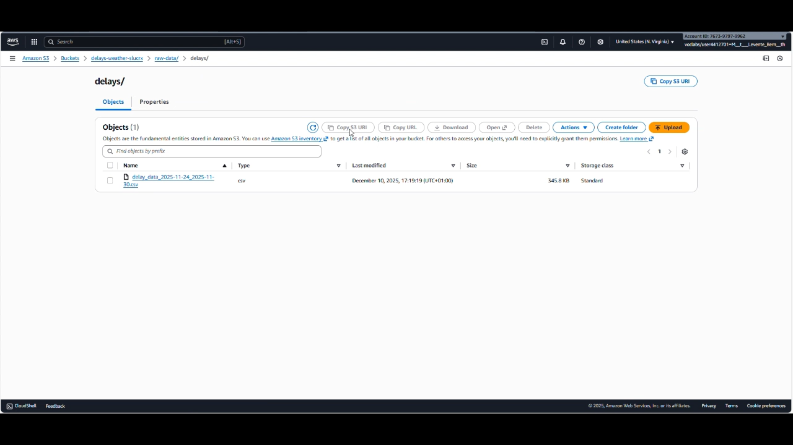
COMPLETE PROCESS SCREEN GRAB

Slide 18
Possible future considerations
Dashboard: QuickSight is blocked in Learner Lab, but would provide native integration of the Athena database into data visualization
Expanding the model: track other variables and apply statistical methods for causal analysis to have more robust findings
Refine thresholds: extreme if outside -5 and +25 °C mean temperature ; above 45 km/h max wind gust ; above 5 mm daily precipitation

Slide 19
Thank you!
All codes, sources and the detailed documentation can be found on my GitHub repository

Slide 20
Technical details
GitHub repository: Bernáth Máté GitHub
Contributors added to repository: szabild@yahoo.com and balint.matyus@gmail.com
Course: Large-Scale Data Architectures - 2025/26 Autumn (ADIN012NABB)
Instructor: Borbásné-Szabó Ildikó
Platform: Final Project executed in AWS Learner Lab [ALLv2EN-US-LTI13-135597]
Delay data source: Ferenci Tamás GitHub
Weather data source: Open-Meteo Archive Weather API
Station coordinates source: Ferenci Tamás GitHub

